Slide 1
Labor and Financial Markets

Slide 2
Labor markets
Labor markets refer to the supply and demand of labor in the market. In this market, both the employees and employers bargain for labor and wages/salary.
The demand of labor usually determines the equilibrium point of wage, and they should be equal. Thus, it means that high order of laborers/employees will result in increased wages or salaries.

Slide 3
Theories of labor market
Labor markets can be grouped into two separate theories, also known as dual labor markets. They are the primary sectors and Secondary sectors.
In most cases, the two labor sectors have been centered under public welfare, at times discrimination, and poverty.
This action is what groups different citizen's statuses based on their social statuses, e.g., Wealth.
Piore, (2018)

Slide 4
Factors that affect labor market/ employment.
Labor markets are affected mainly by the demand for goods or services by consumers. This means that the higher the need for a specific service, the higher the labor demand in the field and vice versa.
The size of a firm or company may also affect the employment rate of laborers/employees. Large companies and those that are small but have several branches tend to employ many laborers to help distribute their goods compared to others.

Slide 5
Factors that affect labor market/ employment.
Education is also one of the factors that affect the labor markets. In most cases, employers tend to look for employees to work in specific departments in their companies, requiring employees with unique skills.
For example, a company might require an employee to work in a department with computer skills to operate and control their machines. Therefore, this means that the company will only consider the employees with the skills to handle the computers, inconveniences the rest of the laborers.
Lumsdine, (n.d)

Slide 6
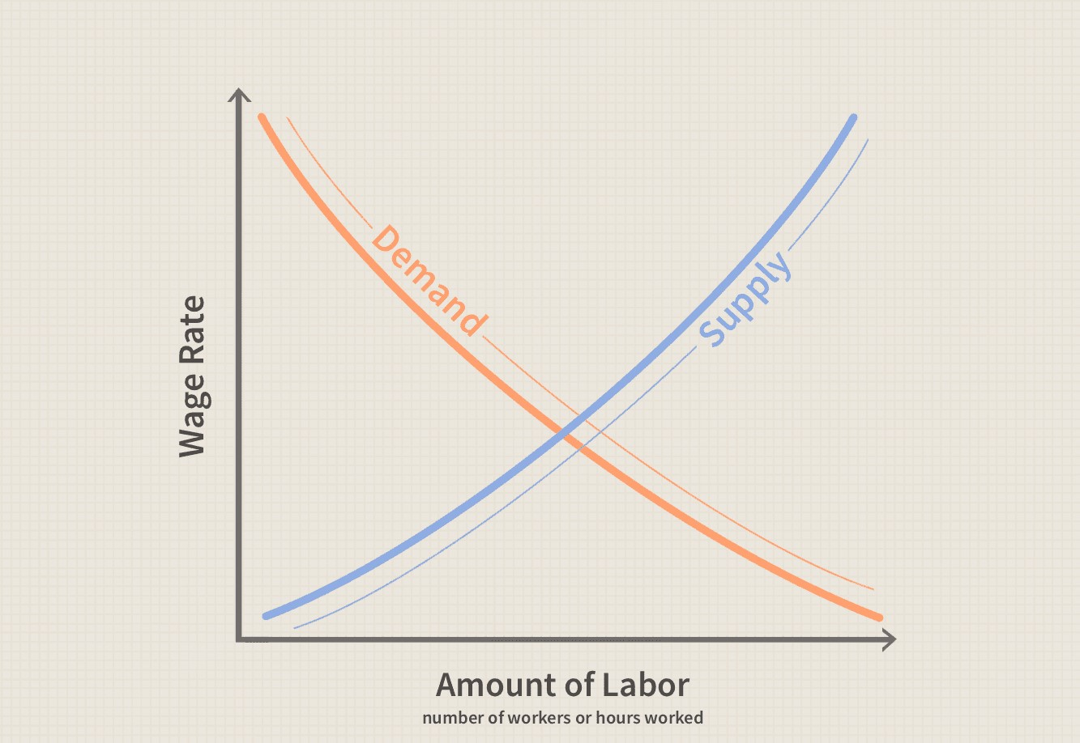
Amount of labor against wage and supply

Slide 7
Types of labors
Professional labor is a common type of labor in large companies. This is the highest level of labor and is based on one's knowledge and education, experience in a specific field. These types of laborers are usually the most highly paid.
Some examples of professional laborers may include; scientists, lawyers, doctors. Skilled laborers are usually rare to find. Also, some large companies employ professionals base on their experience level.

Slide 8
Types of labors
Unskilled labor refers to work or labor that does not require any qualifications or special skills to operate. For example, moping floors, sweeping, etc. These types of jobs do not require any particular skill for one to get employed.
In most cases, these kinds of jobs are usually less in demand, and the number of laborers is usually significant because it only requires basic knowledge.
Burak, (2013)

Slide 9
Types of labors
Skilled laborers are employees that have slightly high skills in specific fields. These laborers tend to work on tasks that require high educations. An excellent example of such employees is carpenters and chefs. These employees usually have slightly higher education from colleges or any post-secondary schools in their fields.
The final group of laborers is the semi-skilled laborers who work on tasks such as dishwashing, electric floor polishing. This group of employees tend to work on basic tasks but with the use of machines. In most cases, companies may only ask for their experience period with such devices as a requirement.

Slide 10
Financial markets
Any marketplace or area where the trading of securities occurs is known as a financial place. It is also a place where companies and organizations exchange their currencies from one to another. A good example is Forex. This is one of the famous financial marketplace used by several companies.
Financial markets help companies to grow their companies through investments and currency trades. These markets also help the government in the construction of roads, hospitals, and also schools.

Slide 11
Importance
One of the importance of financial markets is to attract investors to or within a specific country. Therefore, having more investors in a particular country can make a country's status rise through investors who invest in these markets.
Also, a country’s social standard can rise through such investments since they will get loans from these markets, thus, maintaining the country’s economy. For a government to keep its financial markets high, its productivity should also be high, which guarantees investors the safety of their investments.

Slide 12
Importance
In addition, the financial markets also help allocate and ensure the liquidity of capital in the country. This means that they take investments from investors and give them loans or investments to those who require them.
Thus, it ensures the flow of cash in the country to improve the economy. However, not all organizations qualify to get loans from these organizations. These markets only provide fluid money to an organization that shows the ability to regain or survive long enough to get their investments back.

Slide 13
Factors that affect financial markets
Several factors affect financial markets. One of them is the Economy. Some macroeconomics factors like inflation and interest rates may affect the financial markets due to unexpected changes in taxes that affect business.
If the rate of unemployment or inflation in a specific country goes high, then economic growth will be reduced in the future. Also, if the rate of unemployment and inflation decrease, this will mean that the given nation's economy dramatically improves, affecting the financial markets positively.
Petinger, (2019)

Slide 14
Factors that affect financial markets
Another factor that may affect the financial market is politics in a given nation. Incase one of the investors is involved in politics, the markets may be affected during elections or campaigns. This action is mostly seen in non-democratic countries.
In case of a strike, the markets may be affected negatively, impacting the whole nation. Therefore, some stock markets do not take investments from countries that are likely to incur post-election strikes or violence t avoid loss.

Slide 15
Factors that affect financial markets
Market psychology also affects the markets. Human beiges are the central aspect of this situation since they are in charge of raising or dropping prices in the market.
When humans buy more, the financial market status also rises, and vise versa is also true. Therefore this means that human activities also impact the market status base on their day to day life
Northern University (2019).

Slide 16
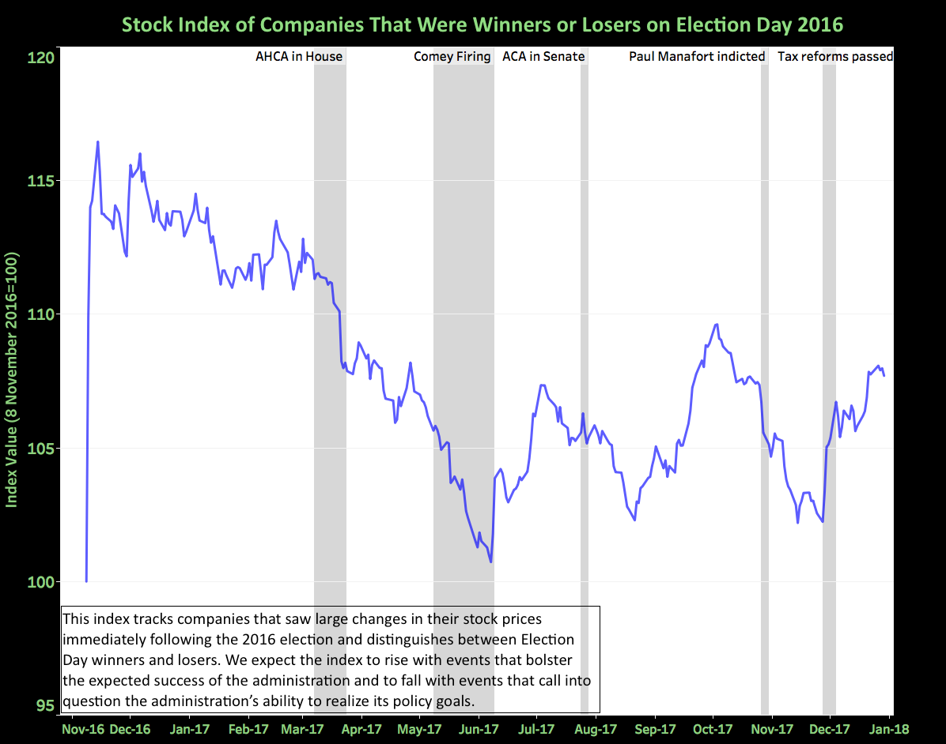

Slide 17
References
- Piore, M. J. (2018). The dual labor market: theory and implications (pp. 629-640). Routledge.
- Burak, E. (2013). The four types of labor. prezi.com. https://prezi.com/jyxp2xiq5mf7/the-four-types-of-labor/
- Lumsdine, R. M. (n.d.). 3 factors affecting labor supply decisions and retirement income | Assessing knowledge of retirement behavior | The National Academies Press. The National Academies Press. https://www.nap.edu/read/5367/chapter/4#63
- Northern University. (2019). Factors that affect global financial markets | Northeastern University. Northeastern University D’Amore-McKim School of Business. https://onlinebusiness.northeastern.edu/blog/global-factors-that-impact-the-world-of-finance/
- Pettinger, T. (2019). Factors affecting the stock market. Economics Help. https://www.economicshelp.org/blog/2841/economics/factors-affecting-the-stock-market/

